Slide 1
Recitation Week 8
Giang Nguyen

Slide 2
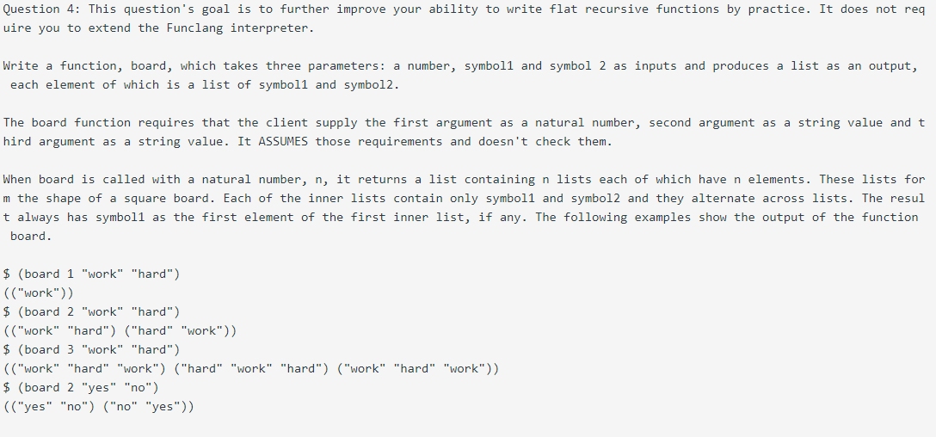
Question 1

Slide 3
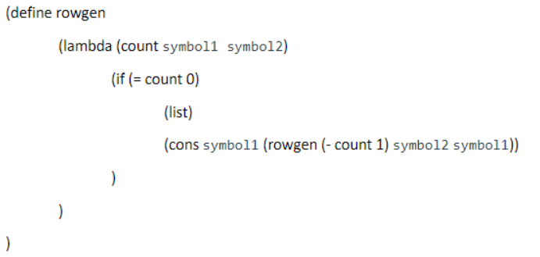
Row generate

Slide 4
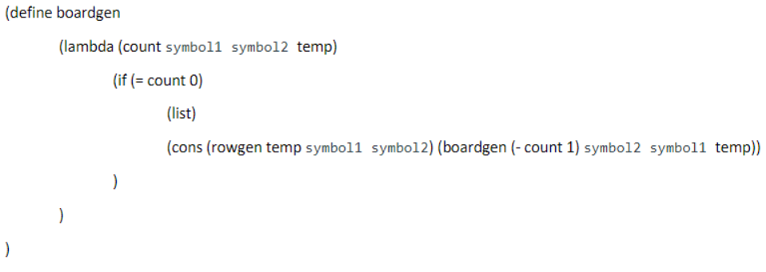
Board generate

Slide 5
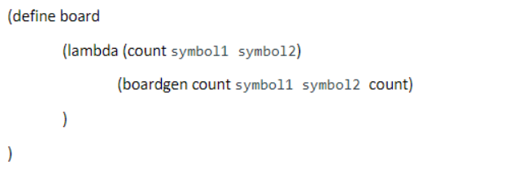

Slide 6
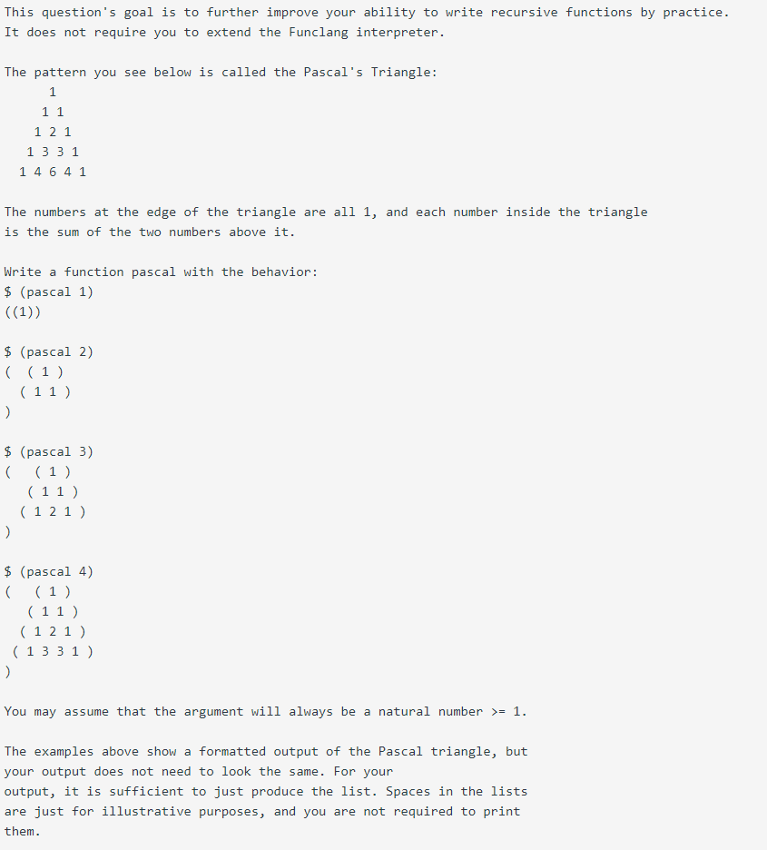
Question 2

Slide 7
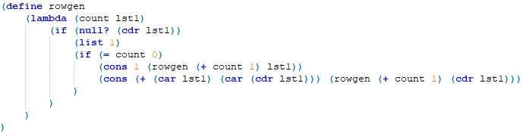
Row generate

Slide 8
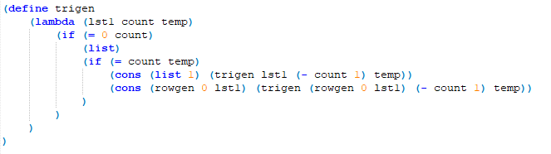
Triangle generate

Slide 9

Pascal Triangle generate

